Slide 1
Project 3
An Analysis of Sodium in the Sun
Greg Costa, Omar Kotrach, Matthew Williard, Dax Begeny

Slide 2
Introduction
Light Spectra
Emission and Absorption of different wavelengths of light
Tells us elements contained in an object
Stellar Abundance
Light spectra done on a star
Tells us what elements are in a star
We will do a stellar abundance spectra focusing on Sodium (Na)
Compare sodium to other elements
Notes:
For background, a Light Spectra is measuring the intensity of light across many different wavelengths, noting any large peaks or valleys, which are emission or absorption lines. These can tell us what elements are present in an object we are observing. This can be done on a star in order to find a Stellar Abundance. This is the elements most contained
We used absorption lines for our analysis
G: In our study, we focus on the solar sodium doublet lines to estimate the abundance of sodium relative to hydrogen, in both Physicist and astronomers term
1. What a spectra is
2. What a spectra can tell us
3. We will analyze the Sun’s Na spectrum

Slide 3

Motivation
To understand the Sun’s chemical composition
What we learn from our Sun, can be applied to other distant stars
To investigate other elements’ spectrum lines
Notes:
G: The sun plays a crucial role in shaping our understanding of stellar astrophysics. Studying its chemical composition allows us to decipher processes occurring within the sun and provides a foundation for exploring other stars and to understand their behavior. And with what we learn, we can apply the same methods to study other elements’ spectrum lines

Slide 4
Methods
01 Data from BASS2000
02 Create Spectroscopy Plot for Na
03 Compute Boltzmann and Saha Equations
04 Answer Various Questions
Notes:
Omar

Slide 5
Results & Discussion
The answers and what they mean
Notes:
For the purposes of the presentation, and because the results and discussion are so similar, we decided to discuss our results as we go.

Slide 6
Assumptions
T = 5780 K
Pₑ= 1 N/m²
P
e
​
Notes:
We chose an effective temperature of 5780 K for the Sun, and an electron pressure of 1 N/m^2.

Slide 7
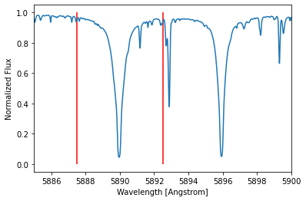
Notes:
This is the sodium spectrum, which also our key figure. The red lines indicate the region of which we will be calculating the equivalent width of. We don’t want these lines to be too close, as that would ignore much of the peak. But we also don’t want these lines to be too far apart, as that would include too much of the background.

Slide 8
0.83 Å
Equivalent Width
Notes:
This is the equivalent width that was calculated from the previous solar spectrum plot.

Slide 9
8.2e14
atoms/cm^2
What is the number density of Na atoms in the ground state?
Notes:
G: The ground state is the lowest energy state of an atom. And we found the density in the ground state in 8.2 atoms per centimeter squared.

Slide 10
22.8
Ground Na to Excited Na
Notes:
This is the ratio of ground state Na atoms to excited state Na atoms, which was calculated using the Boltzmann equation. This indicates there are many more ground state Na atoms than excited state atoms. This makes sense, as the ground state of an atom is much more stable than the excited state.

Slide 11
8.6e14
atoms/cm^2
What is the number density of neutral Na atoms?
Notes:
G: A neutral atom are those that have not lost any electrons. And we found that for every square centimeter there is 8.6e14 atoms

Slide 12
2.16e18
atoms/cm^2
What is the number density of ionized Na atmos?
Notes:
G: To compute all the Sodium atoms, we cannot assume that the neutral atoms are the only ones present in the solar photosphere. We need to add the Ionized atoms, which are those that have lost one or more electrons through ionization. We found the number density of ionized atoms to be: 2.16e18

Slide 13
2517.9
Ionized Na to Neutral Na
Notes:
The ratio of ionized Na atoms to neutral Na atoms is. Thai was calculated using the Saha Equation. For every one neutral Na atom, there are roughly 2518 ionized atoms This makes sense, due to all the energy and heat in the Sun that likely ionizes many of the neutral Na atoms
Energy of 496 KJ/mole

Slide 14
2.16e18
atoms/cm^2
The Total Number Density of Na Atoms
Notes:
This is the total number density of Na atoms in all states in the Sun. While this may seem large, note that sodium only makes up about 0.005% of the Sun’s mass.

Slide 15
Abundances
In Physics Terms | In Galactic Astronomy Terms | In Stellar Astronomy Terms
1.99e-6 | 6.5 | 0
Notes:
What do these values mean? Well, they all mean the same thing just in different notations. The physicist version is the mole ratio between Na and H. The galactic astronomy version is log of the mole ratio between Na and H, with an offset of 12. And the stellar astronomy version is just the log of the mole ratio divide by the mole ratio of the Sun, and since we are using the Sun’s spectrum, we get a log of 1, which is 0.
G: Our findings demonstrate the utility of the sodium doublet lines in determining the abundance of Sodium in the Sun’s photosphere. Also, our results contribute to our understanding of the chemical composition of our sun.

Slide 16
Bonus
Sulfur (S)
Notes:
G: Dax analyzed the spectral lines of the element of Sulfur

Slide 17
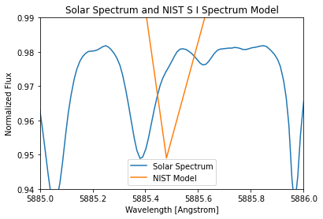
Notes:
G:This is Sulfur spectrum. Sulfur dip was found using spectra data from National Institute of Standards and Technology and comparing the model to the solar spectra

Slide 18
Notes:
G: The small dip where the left right line is the dip for sulfur.

Slide 19
Equivalent Width | Total number density of S atoms in all states | In Physics Terms | In Galactic Astronomy Terms | In Stellar Astronomy Terms
9.44e-3 Å | 3.05e17 atoms/cm^2 | 1.47e-5 | 7.17 | 0
Notes:
G: Equivalent width: 9.44e-3 Armstrongs
Total number density of Sulfur atoms in all states: 3.05e17 atoms per centimeter square
In physics terms: 1.47e-5
In galactic Astronomy terms 7.17
And in Stellar astronomy: 0

Slide 20
Conclusion
Sodium (Na)
Abundance found to be 6.5 compared to the actual value of 6.3
Sulfur (S)
Abundance found to be 7.17 compared to the actual value of 7.17

